Slide 1
Hierarchical Personalized Federated Learning for User Modeling
成新宇
2021年10月15日
[1] Wu J, Liu Q, Huang Z, et al. Hierarchical Personalized Federated Learning for User Modeling[C]//Proceedings of the Web Conference 2021. 2021: 957-968.

Slide 2
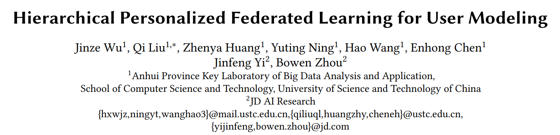
前言
User modeling
An important basis to capture useful potential characteristics with the reliance on personal data
User modeling has been applied to multiple typical tasks, such as modeling capabilities or preferences from users
User modeling processes usually centralized training with data aggregated, which causes privacy leakage

Slide 3
01
背景介绍
02
联邦推荐系统
03
HPFL
04
总结思考

Slide 4
背景介绍
Notes:
接下来是第一部分，背景介绍

Slide 5
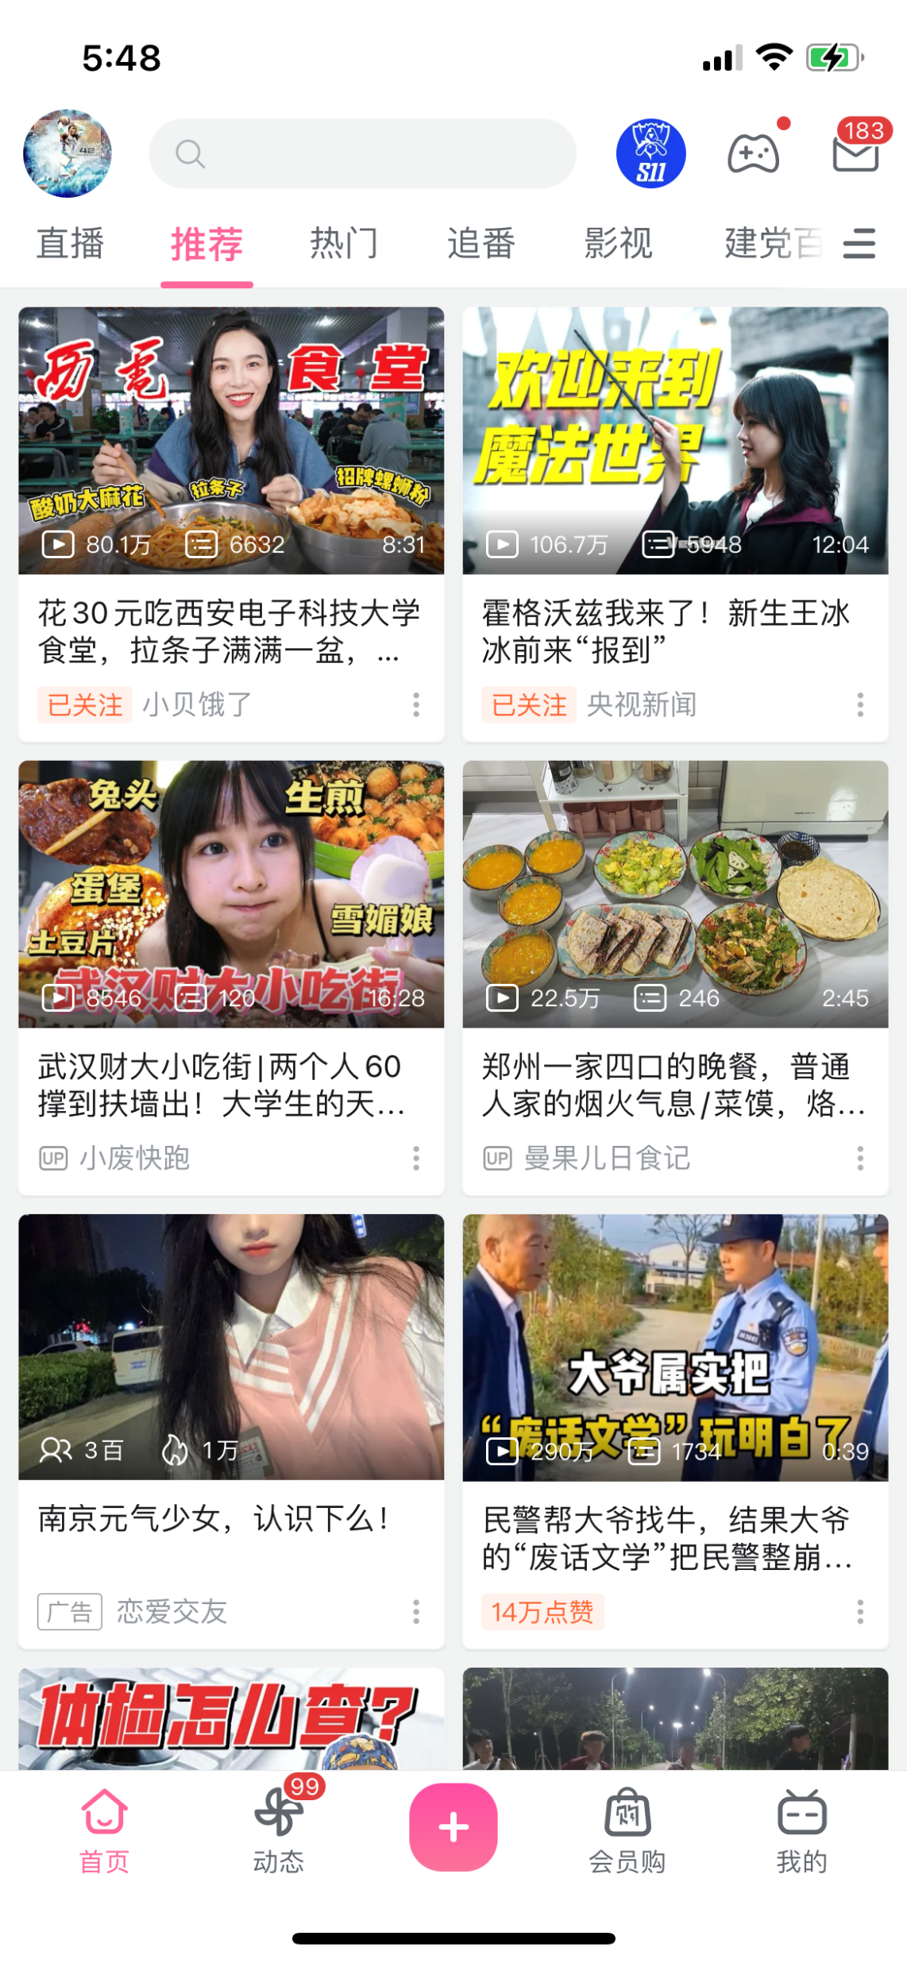

推荐无处不在

Slide 6
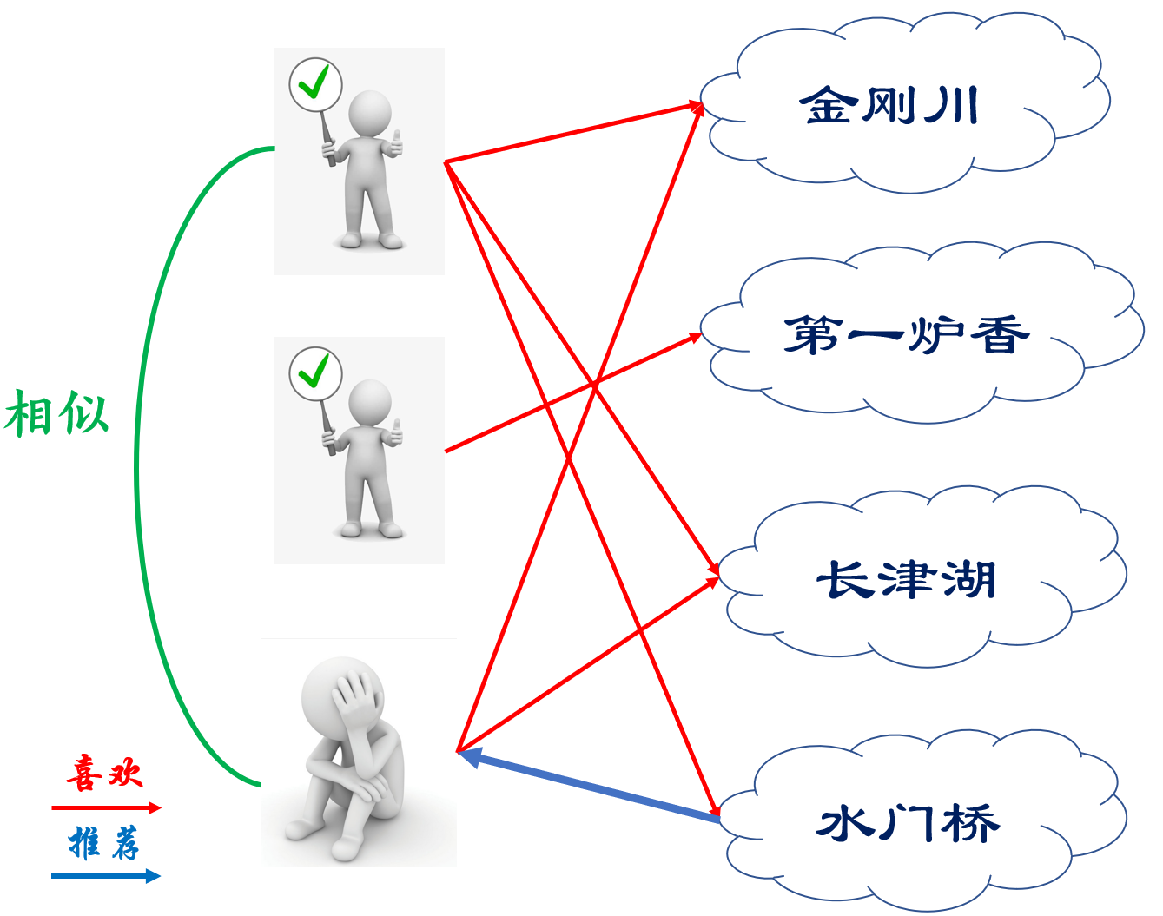
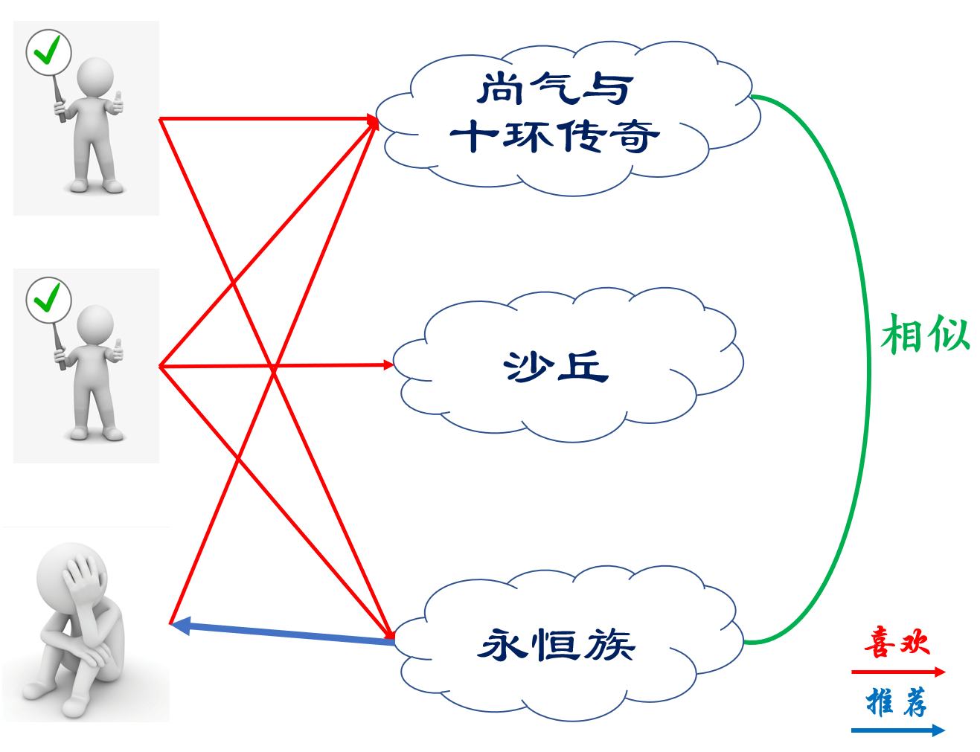
协同过滤基本思想
user-based
item-based

Slide 7



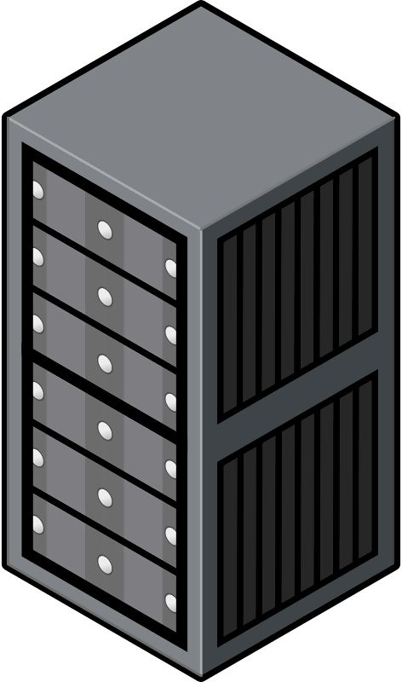





云中心训练模式
云训练中心
Ⅰ收集数据
在终端上利用APP收集用户数据
Ⅱ传输数据
将终端上收集的数据传输至云中心
Ⅲ训练模型
云中心对这些数据进行处理，然后
利用这些数据训练推荐模型

Slide 8
云中心训练模式的不足
数据规模大
隐私问题
云中心的困境
智能手机越发普及，各种APP层出不穷，为了做好推荐功能需要采集用户数据，但若将用户数据全部发送到云中心，将给主干网带来巨大传输压力。
2018年欧盟颁布通用数据保护条例（GDPR）,2020年10月《中华人民共和国个人信息保护法(草案)》全文公布，公众数据隐私保护越发得到关注。
巨大的数据量和复杂的推荐模型使得云服务器的可扩展性受到挑战，以及由此所需的庞大的计算和存储资源使得运维成本上升。
庞大数据规模、终端数据隐私与云服务器的高性能要求均对基于云数据中心的传统训练方式提出了新的挑战
联邦推荐系统

Slide 9
联邦推荐系统

Slide 10
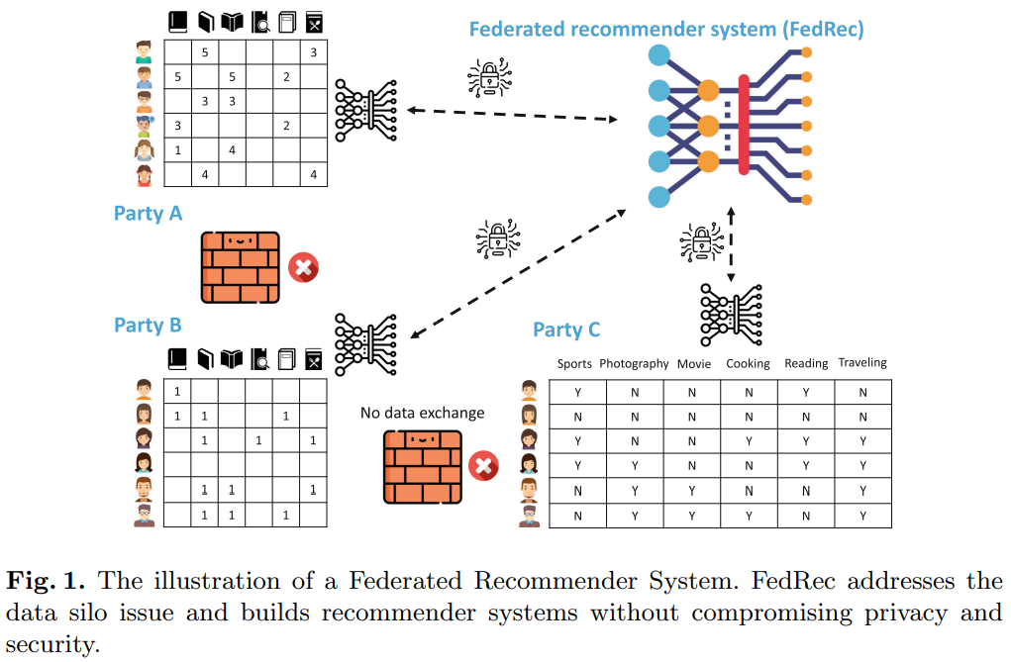
Federated Recommender System^{[2]}
 Definition
FedRec aims to collaboratively train recommendation model(s) among multiple parties without direct access to the private data of each other.
[2] Yang L, Tan B, Zheng V W, et al. Federated recommendation systems[M]//Federated Learning. Springer, Cham, 2020: 225-239.

Slide 11
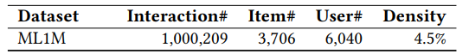
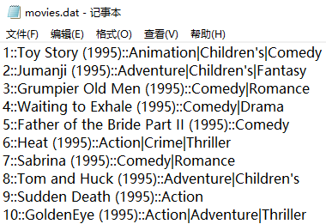
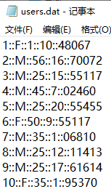
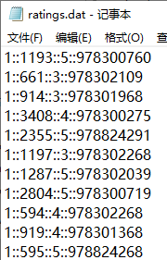
数据
电影：MovieID::Title::Genres
用户：UserID::Gender::Age::Occupation::Zip-code
评价：UserID::MovieID::Rating::Timestamp
[3] https://grouplens.org/datasets/movielens/1m/

Slide 12
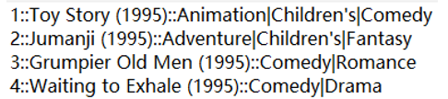
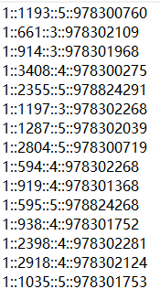
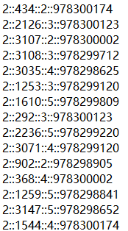
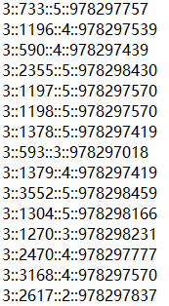
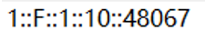
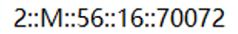
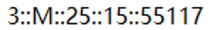
数据分布
Public：

Slide 13
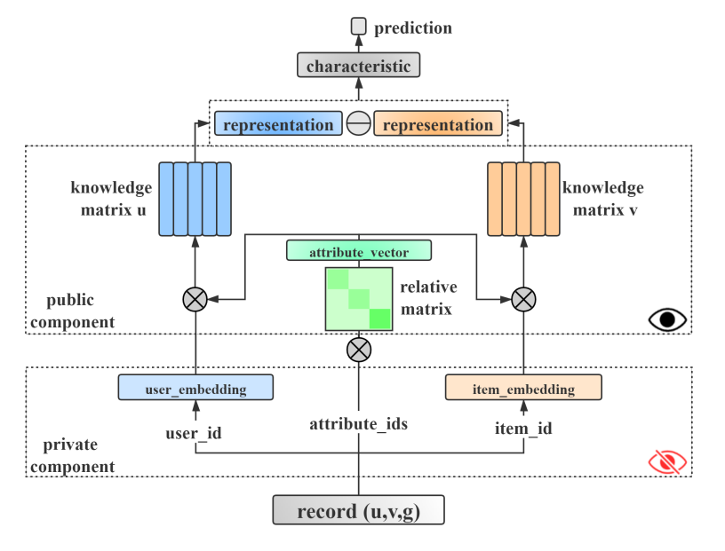
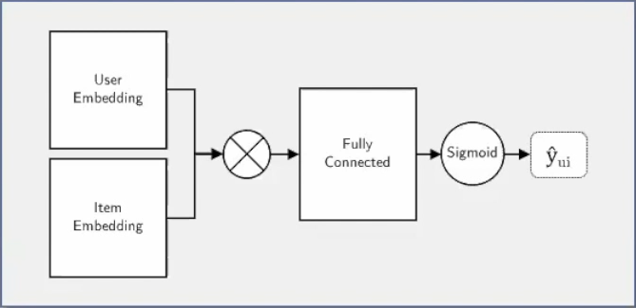

推荐模型
Parameter Set：

Slide 14
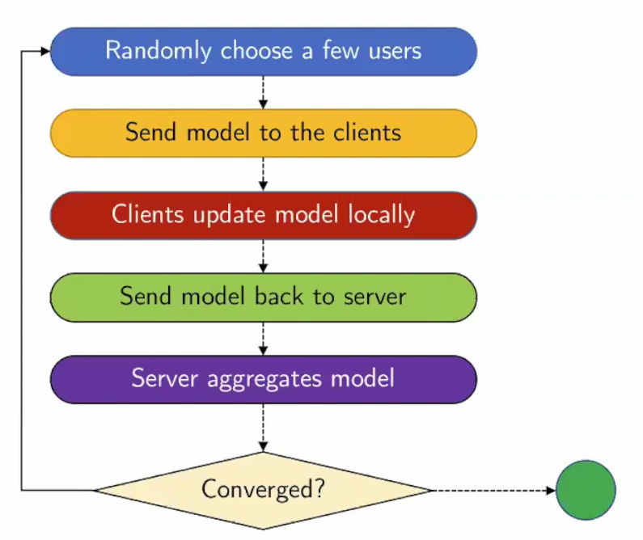
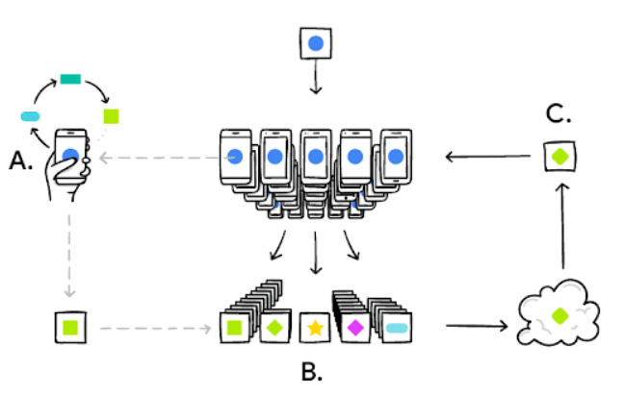
训练过程
联邦平均（Federated Averaging）
FAVG算法流程示意图^{[4]}
[4] https://medium.com/tensorflow/introducing-tensorflow-federated-a4147aa20041

Slide 15
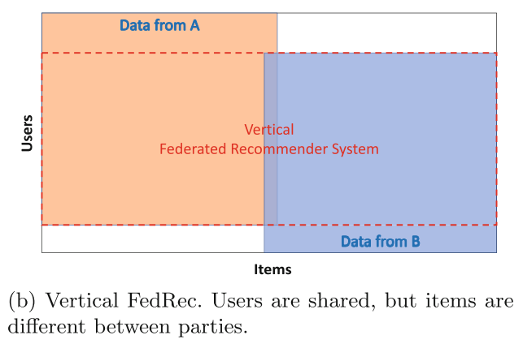
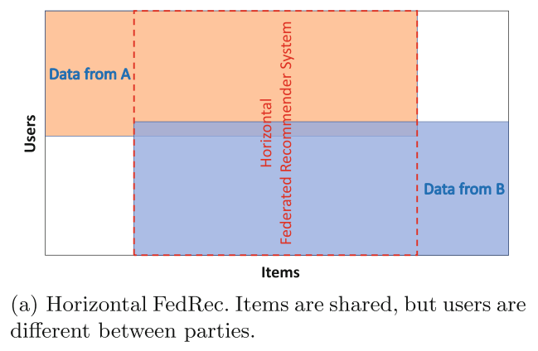
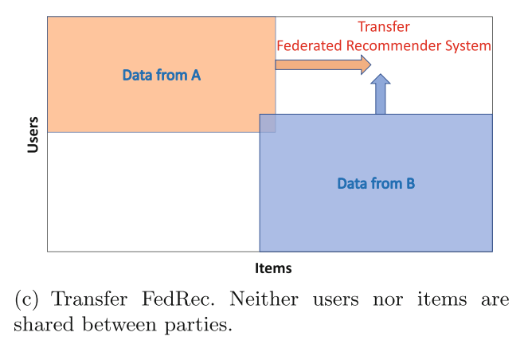
联邦推荐系统的分类

Slide 16
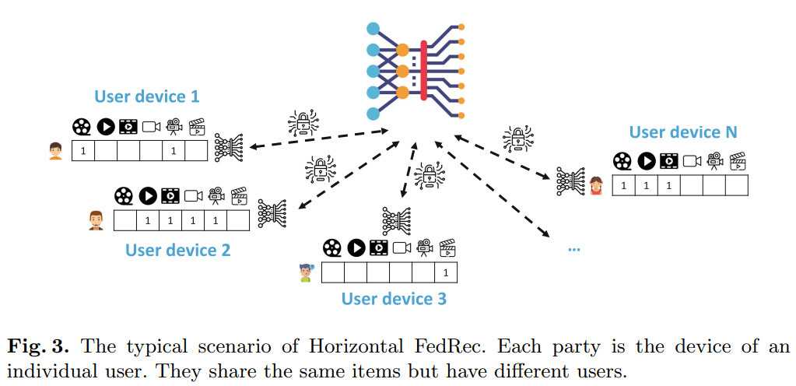
Horizontal FedRec

Slide 17
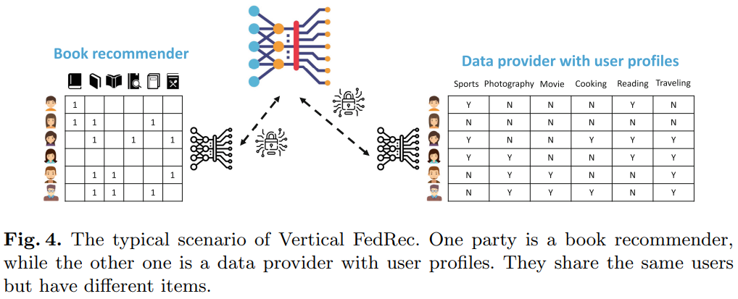
Vertical FedRec

Slide 18
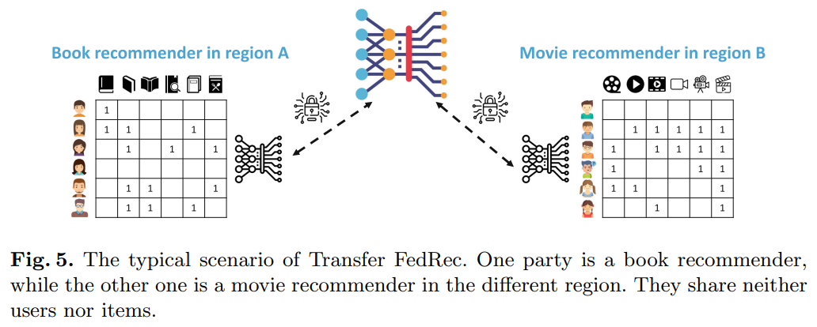
Transfer FedRec

Slide 19
发展现状
As we have reviewed, horizontal FedRec managing RecSys across individuals or user sets is important and attracts lots of research attention. Vertical FedRec and transfer FedRec building RecSys among organizations are typical tasks in recommendation businesses. Yet, vertical and transfer FedRec are still underexplored areas with a lot of opportunities.
[1] Wu J, Liu Q, Huang Z, et al. Hierarchical Personalized Federated Learning for User Modeling[C]//Proceedings of the Web Conference 2021. 2021: 957-968.
[5] Muhammad K, Wang Q, O'Reilly-Morgan D, et al. Fedfast: Going beyond average for faster training of federated recommender systems[C]//Proceedings of the 26th ACM SIGKDD International Conference on Knowledge Discovery & Data Mining. 2020: 1234-1242.
[6] Liang F, Pan W, Ming Z. FedRec++: Lossless Federated Recommendation with Explicit Feedback[C]//Proceedings of the AAAI Conference on Artificial Intelligence. 2021, 35(5): 4224-4231.
[7] Lin Y, Ren P, Chen Z, et al. Meta Matrix Factorization for Federated Rating Predictions[C]//Proceedings of the 43rd International ACM SIGIR Conference on Research and Development in Information Retrieval. 2020: 981-990.
[8] Kalloori S, Klingler S. Horizontal Cross-Silo Federated Recommender Systems[C]//Fifteenth ACM Conference on Recommender Systems. 2021: 680-684.
[9] Chai D, Wang L, Chen K, et al. Secure federated matrix factorization[J]. IEEE Intelligent Systems, 2020.
[10] Minto L, Haller M, Livshits B, et al. Stronger Privacy for Federated Collaborative Filtering With Implicit Feedback[C]//Fifteenth ACM Conference on Recommender Systems. 2021: 342-350.

Slide 20
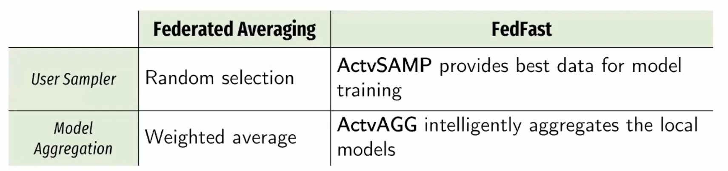
研究内容
如何更好的研究符合实际场景的本地数据（Non-IID数据）
如何挑选有代表性的本地模型参与训练
如何在服务器端进行更加有效的参数聚合
如何用尽可能少量的交互而达到最优效果
如何在参数上传下载过程中进行安全与隐私保护
Conference/Journal | Paper Title | Server |  |  | Client
 |  | Selection | Compression | Aggregation | Train | Compression | Encryption
KDD 2020 | FedFast |  |  | 
WWW 2021 | HPFL |  |  |  | 

Slide 21
HPFL

Slide 22
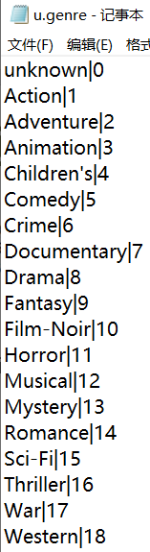
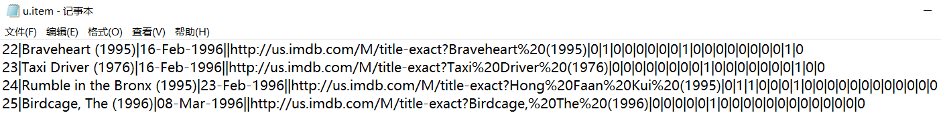
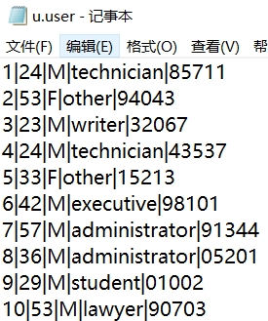
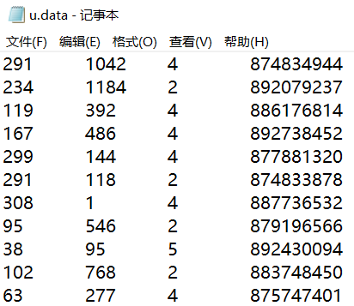
数据
MovieLens 100K Dataset:
Stable benchmark dataset.
100,000 ratings from 1000 users on 1700 movies.
电影：movie id | movie title | release date | video release date | IMDb URL | category
19 categories
用户：user id | age | gender | occupation | zip code
交互：user id | item id | rating | timestamp
[11] https://grouplens.org/datasets/movielens/100k/

Slide 23
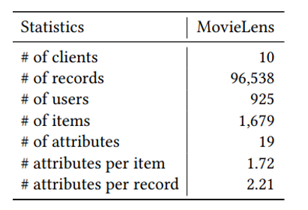
数据分布
divide the data into clients according to users’ location via national area in zipcode
delete the clients with fewer than 5 customers

Slide 24
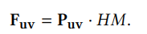
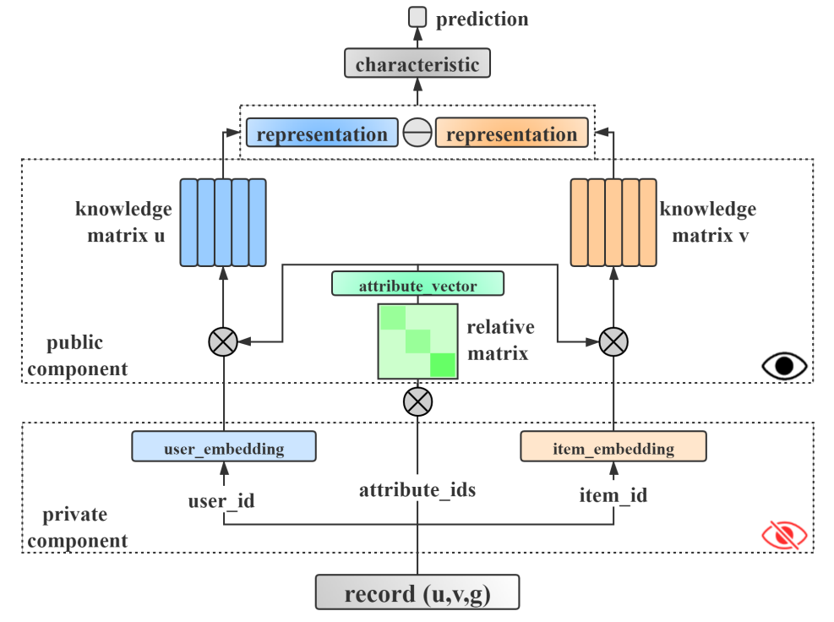
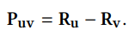
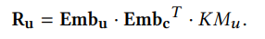
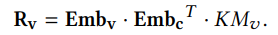
推荐模型
K维 向量
N×1hidden mapping matrix (HM)
K×N 矩阵
K×N 矩阵
K×N 矩阵
K×N 矩阵
K维 Emb_{c}
*N-dimensional knowledge vectors of K categories
实验中设置N为5
K×K
knowledge relation among K categories
K维 Emb_{u}
K维 Emb_{v}
multi-hot vectors
K维 向量

Slide 25
Inconsistent Clients
Statistical heterogeneity
users in clients have different habits
Non-Independently Identically Distributed (Non-IID)
Privacy heterogeneity
different information have different levels of privacy
Public information: it refers to the information that contains the prior domain knowledge so that it can be shared among clients.
the embeddings contain extreme private information, which can be used to infer local data distributions, so that they are defined as private components.
Private information: it is the information which is proprietary for clients and represents the unique distributions of users and items among each client.
the knowledge in matrixes is relatively public and difficult to be used to detect private information. Therefore, we define these components of GUM as public components.
?
Model heterogeneity

Slide 26
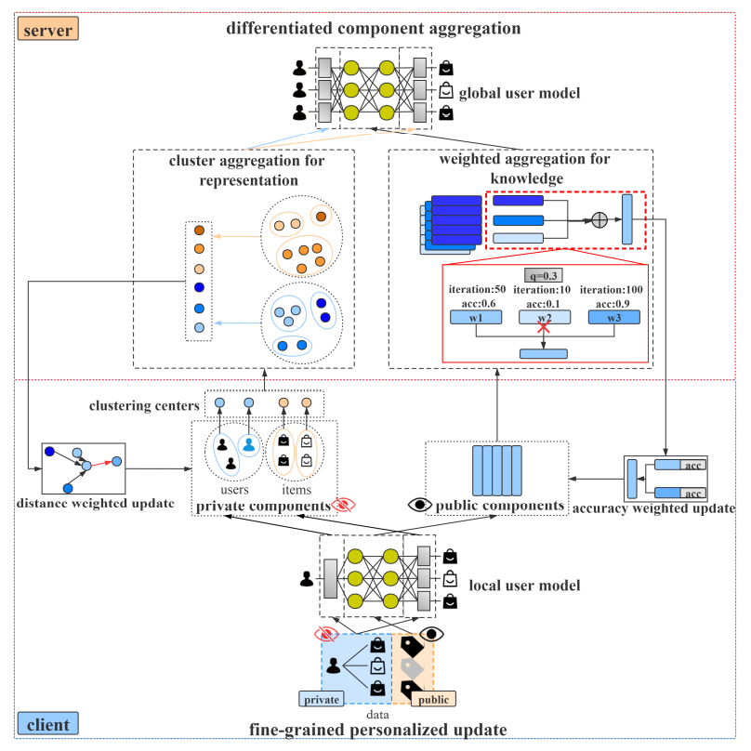
HPFL Overview
创新点：
differentiated component aggregation
fine-grained personalized update
作者自评：
To the best of our knowledge, HPFL is the first framework for federated user modeling tasks, which is specifically designed to take into account both differentiated component aggregation and fine-grained personalized update strategy.
K-means
K is 1/10 of the numbers of inputs

Slide 27
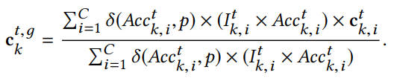
Differentiated component aggregation
Aggregation for public components
weighted aggregation of the same attribute to obtain the global public components
fuse each knowledge vector that represents knowledge information on attribute k from clients i in reference to both the number of iterations on attribute k as well as the local validation accuracy
Aggregation for private components
further clustering with all the cluster centers

Slide 28
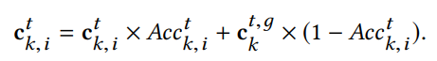
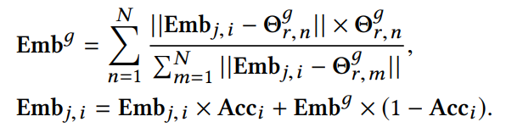
Fine-grained personalized update
For public component: client i add the local attribute knowledge vector and the global attribute knowledge on attribute k via the corresponding accuracy
For private component: the client i distance weighted update new representation with the affects of all global cluster centers

Slide 29
实验设置
实验环境
implemented by PyTorch, and trained on a Linux server with two NVIDIA Tesla K80 GPUs and 256G memory
Baselines
Centrally training methods:
NCF^{[12]}
Traditional Federated methods:
FedSGD, FedAvg, Fednoise, FedProx, FedAtt
Methods in paper:
HPFL-K, HPFL-R, HPFL
评价指标
Prediction Accuracy (ACC)
Mean Absolute Error (MAE)
Root Mean Square Error (RMSE)
Degree of Agreement (DOA)
Normalized Discounted Cumulative Gain (NDCG)
[12] He X, Liao L, Zhang H, et al. Neural collaborative filtering[C]//Proceedings of the 26th international conference on world wide web. 2017: 173-182.

Slide 30
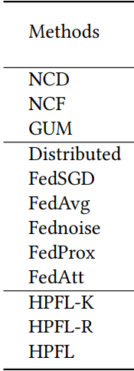
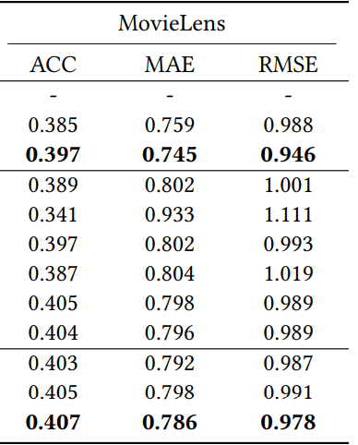
Accuracy performances
GUM model performs better than NCF: capable of deep representation
federated methods perform better, HPFL performs best: harness more information

Slide 31
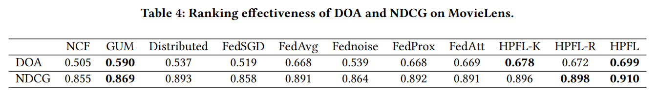
Ranking effectiveness
GUM performs better than centralised methods: high-dimensional user model benefits
HPFL performs outstanding results: both components benefit
distributed training method performs a comparable result in NDCG: standard federated methods bring a coordination among clients

Slide 32
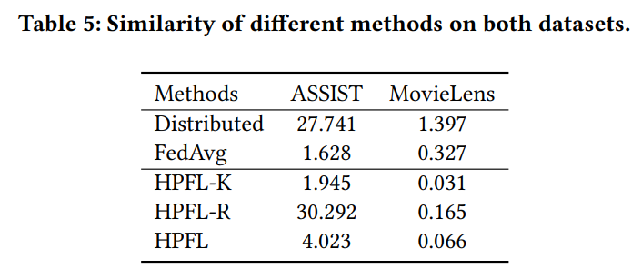
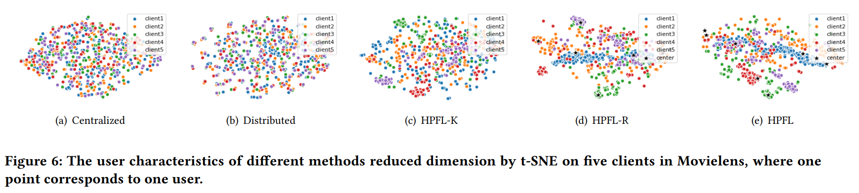
Modeling rationality
Public components share information and promote collaboration among clients while private component tends to capture the uniqueness of users for each client.

Slide 33
总结思考

Slide 34
思考
联邦POI推荐？（瞎想）
从传统的推荐中寻找问题与方法
从传统的联邦学习中寻找问题与方法
如何更好的研究符合实际场景的本地数据（Non-IID数据）
如何挑选有代表性的本地模型参与训练
如何在服务器端进行更加有效的参数聚合
如何用尽可能少量的交互而达到最优效果
如何在参数上传下载过程中进行安全与隐私保护

Slide 35
谢谢观看

